Slide 1
2D GAME IN JAVA USING SWING
Presented By: CSE(AIML)
RAHUL PAL(56)
ABHINANDAN BAKSHI(58)
SAYANTAN GHOSH(67)​

Slide 2
AGENDA
Introduction To Java Swing​
Primary goals
​About the Game Design
Future Scope of The Project
​Summary​

Slide 3
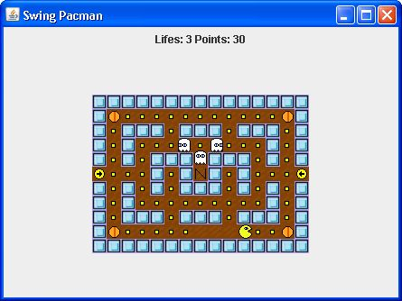
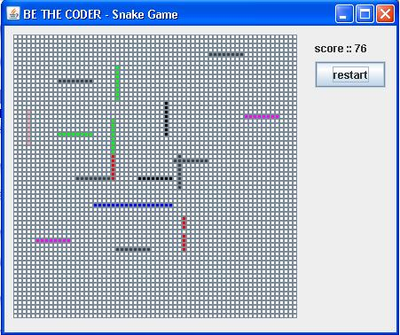
Introduction TO JAVA SWING
Java Swing is a graphical user interface (GUI) toolkit for creating desktop applications. It is part of the Java Foundation Classes (JFC), an API providing a GUI for Java programs. Swing was developed to provide a more sophisticated set of GUI components than the earlier Abstract Window Toolkit (AWT).
Swing can also be used to create 2D graphics, making it a suitable choice for developing simple 2D games. Java Swing is a GUI toolkit for Java. It can be used to create graphical user interfaces for games.
It provides various components for building graphical user interfaces (GUIs), including buttons, menus, text fields, and scrollbars.

Slide 4
PRIMARY GOALS
Swing belongs to the Java Foundation Classes (JFC). However, they are not entirely the same. JFC contains a bundle of other items along with Swing.
Swing has introduced mainly three significant revolutionary advances. It used fewer resources, adds more sophisticated components, and lets the programmer control it’s look-and-feel.
Pluggable look-and-feel enabled the programmers to make software look the same in any platform as designed for that same system.
The Java Swing API GUI is composed of three segments, Components, Containers, and layout managers.

Slide 5
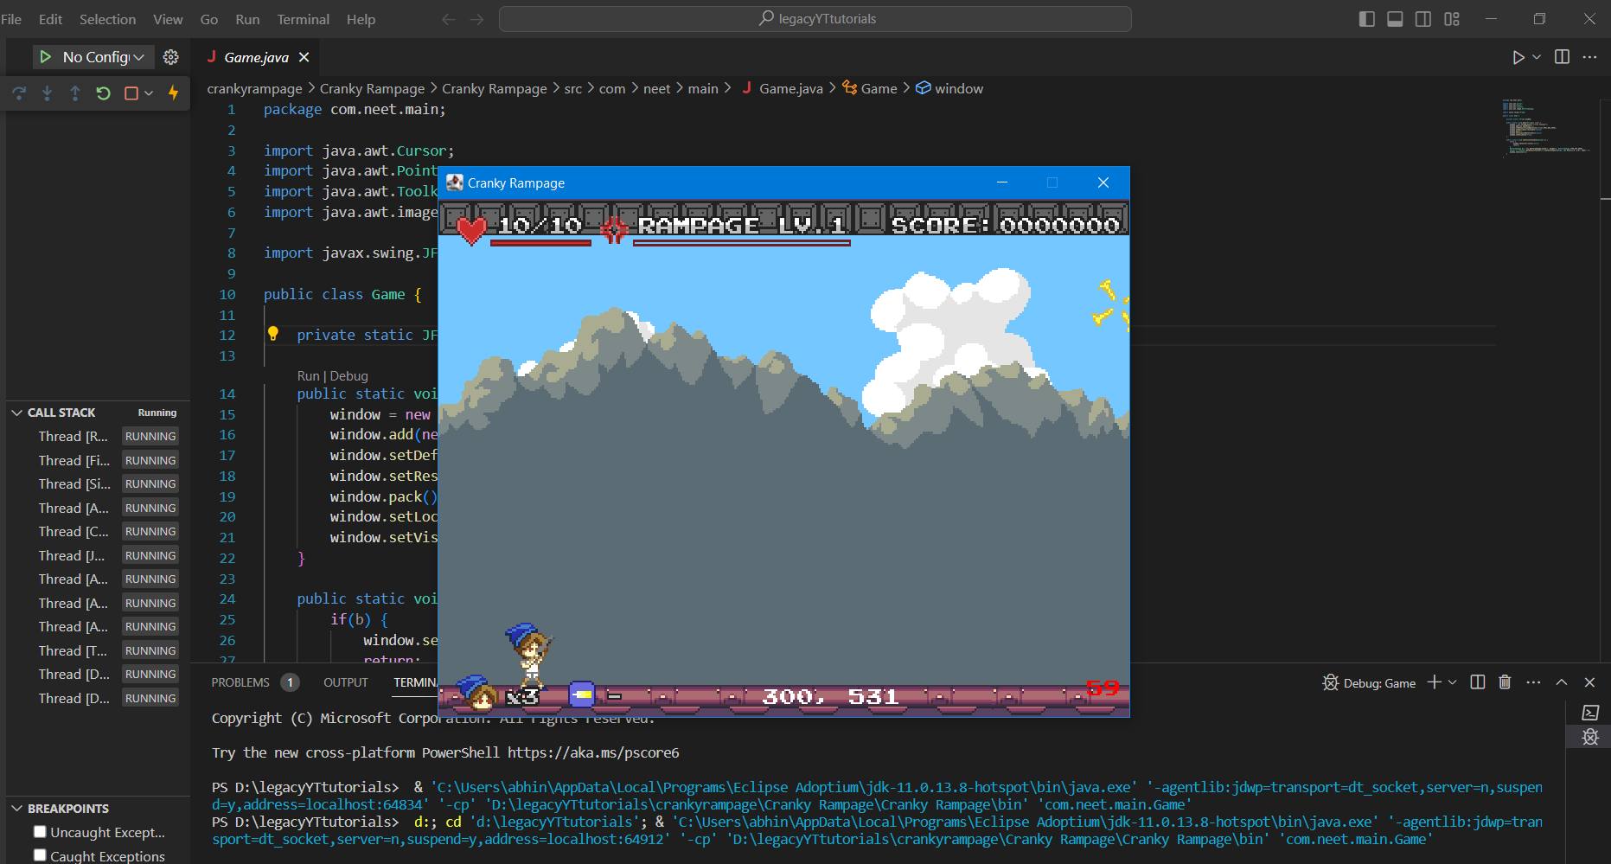
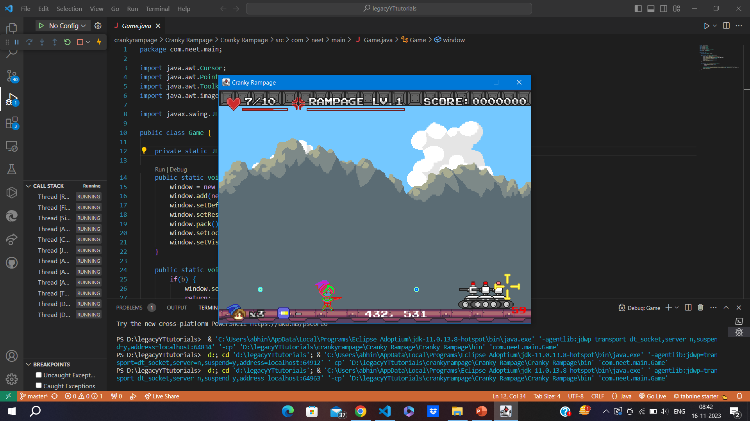
Game DESIGN:

Slide 6
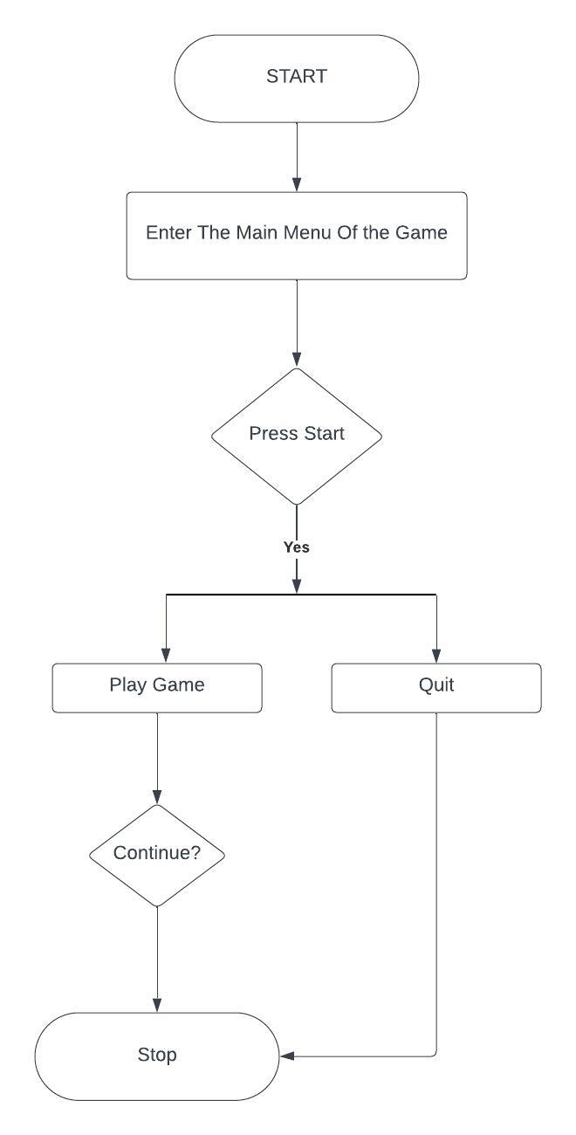
ER Diagram Of the Project

Slide 7
Features Of The Game
Cranky Rampage is an arcade game developed.
The player must avoid obstacles such as cement mixers, falling barrels, and Cranky Kong, who throws objects at Donkey Kong Jr.
The game has four levels, each with its own unique challenges. The first level is the construction site, where Donkey Kong Jr. must avoid cement mixers and falling barrels. The second level is a pipe maze, where Donkey Kong Jr. must find his way through a series of pipes to reach the next level. The third level is a rope ladder climb, where Donkey Kong Jr. must climb up a rope ladder to reach the top of the construction site. The fourth level is the final confrontation with Cranky Kong, where Donkey Kong Jr. must defeat Cranky Kong in order to rescue his father.
There are two power-ups in Cranky Rampage: the helmet and the hammer. The helmet protects Donkey Kong Jr. from one hit from an enemy. The hammer allows Donkey Kong Jr. to break barrels and stun enemies.
CrAnky Rampage is a fun and challenging arcade game that is sure to appeal to gamers of all ages. The game's simple gameplay, colorful graphics, and addictive gameplay make it a must-play for any fan of classic arcade games.

Slide 8
Java AWT 2D GRAPHICS
Extensive Shape Drawing Capabilities:
Text Rendering and Layout:
Draw a variety of basic shapes, including lines, rectangles, circles, and ellipses.
Fill shapes with solid colors, gradients, or patterns.
Apply transformations to shapes, such as scaling, rotation, and translation.
Render text with different fonts, styles, and colors.
Control text alignment and positioning.
Apply text effects, such as outlining, shadowing, and antialiasing.
Image Handling and Manipulation:
Advanced Graphics Techniques:
Load and display images in various formats, including JPEG, PNG, and GIF.
Draw images directly onto the canvas.
Apply transformations to images, such as scaling, rotation, and flipping.
Implement antialiasing to smooth edges and improve image quality.
Apply clipping to restrict the drawing area.
Use stroke attributes to control line width, style, and cap.

Slide 9
Future ASPECT & outcomes
Project Challenges:
Recreating the precise timing and behavior of the original arcade game elements.
Optimizing graphics performance for smooth gameplay on various systems.
Ensuring compatibility with different Java Swing environments and operating systems.
Project Outcomes:
A fully functional Cranky Rampage 2D game playable on modern platforms.
Enhanced understanding of Java Swing's graphics capabilities for 2D game development.
Valuable experience in applying game development principles and techniques.
Future Directions:
Further refinement of graphics and sound effects for a more polished gaming experience.
Introduction of additional levels and gameplay elements to expand the game's content.
Exploration of cross-platform deployment options to reach a wider audience.

Slide 10
SUMMARY
The Cranky Rampage 2D Game project involved the development of a classic arcade game using Java Swing technology. The project successfully replicated the core gameplay mechanics and visuals of the original Cranky Rampage arcade game, allowing players to experience the nostalgic title on modern platforms.
Key Features:
Faithful recreation of the original Cranky Rampage gameplay, including climbing levels, avoiding obstacles and defeating Cranky Kong.
Implementation of basic game development concepts, including game loops, collision detection, and user input handling.
Utilization of Java Swing's graphics capabilities to render 2D graphics, including sprites, backgrounds, and animations.
Integration of sound effects and music to enhance the gaming experience.

Slide 11
THANK YOU

